Slide 1

Does eating fish have any health benefit?
Ifeanyi Chukwu
Cardiovascular Epidemiology Unit
Summer Internship Research Project
6 August 2021

Slide 2
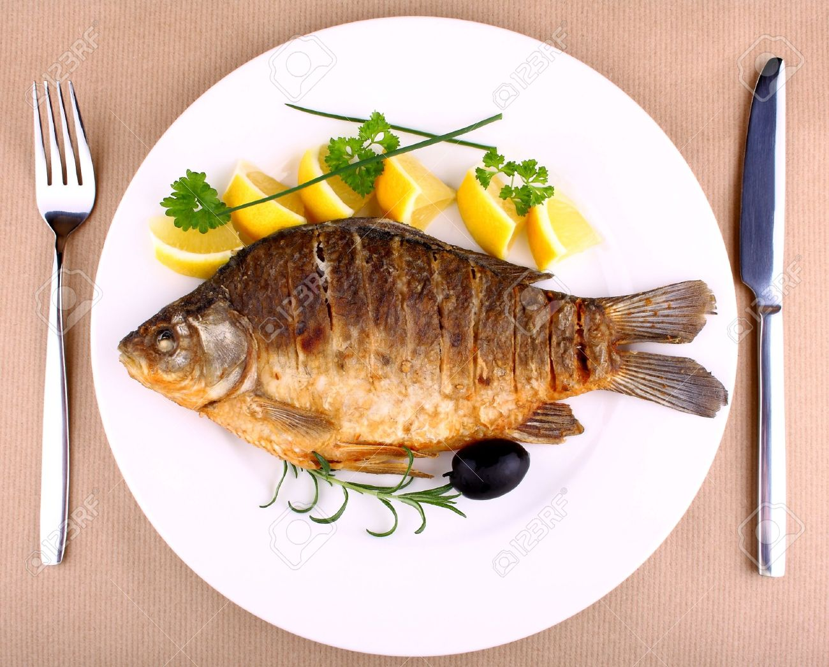
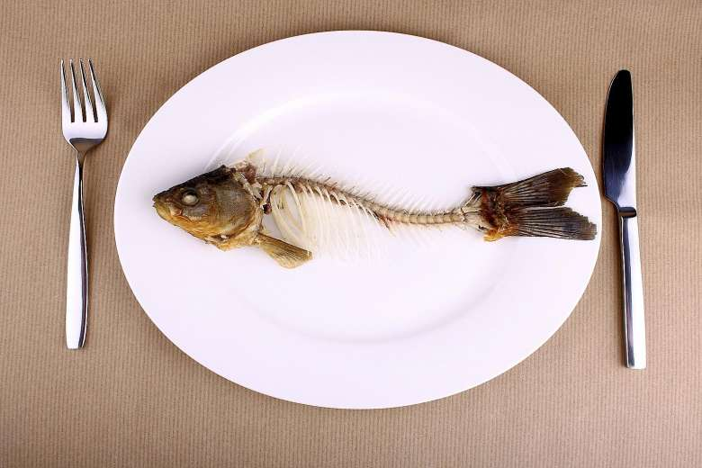
Introduction
About 3 billion people rely on fish as source of protein – World Wildlife Fund
Fish is the perfect protein…

Slide 3
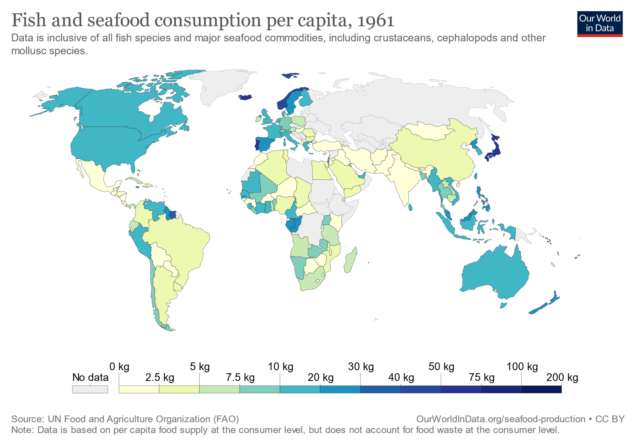
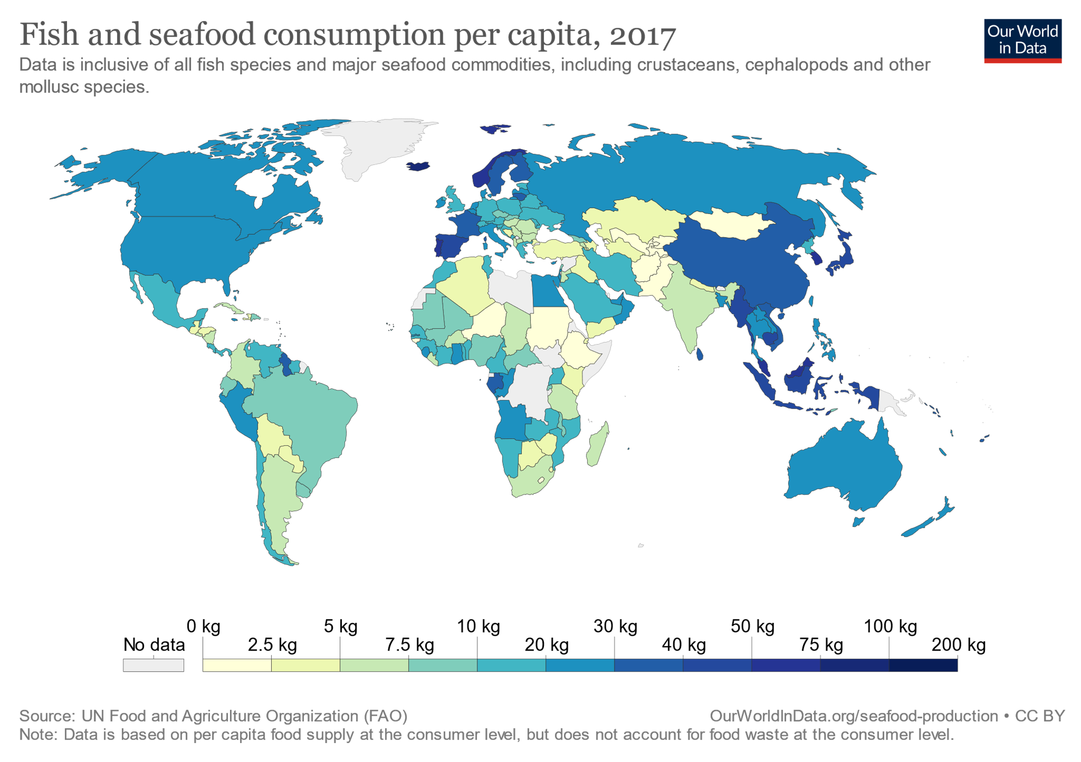
The changing World Fish Eating Habit
1961
2017

Slide 4
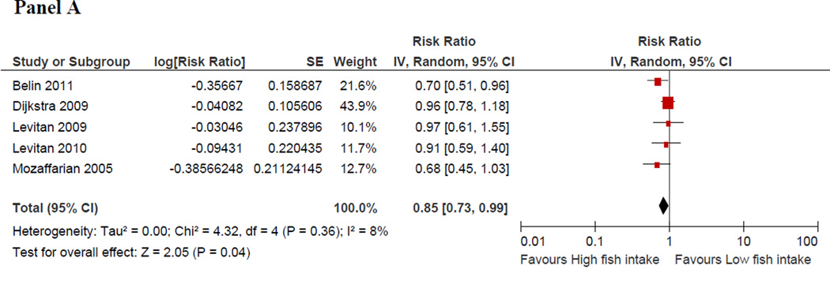
Previous Studies on Health Benefit of Fish Consumption
Fish intake and risk of Heart Failure
Observational Study:
Djousse et al. 2012

Slide 5
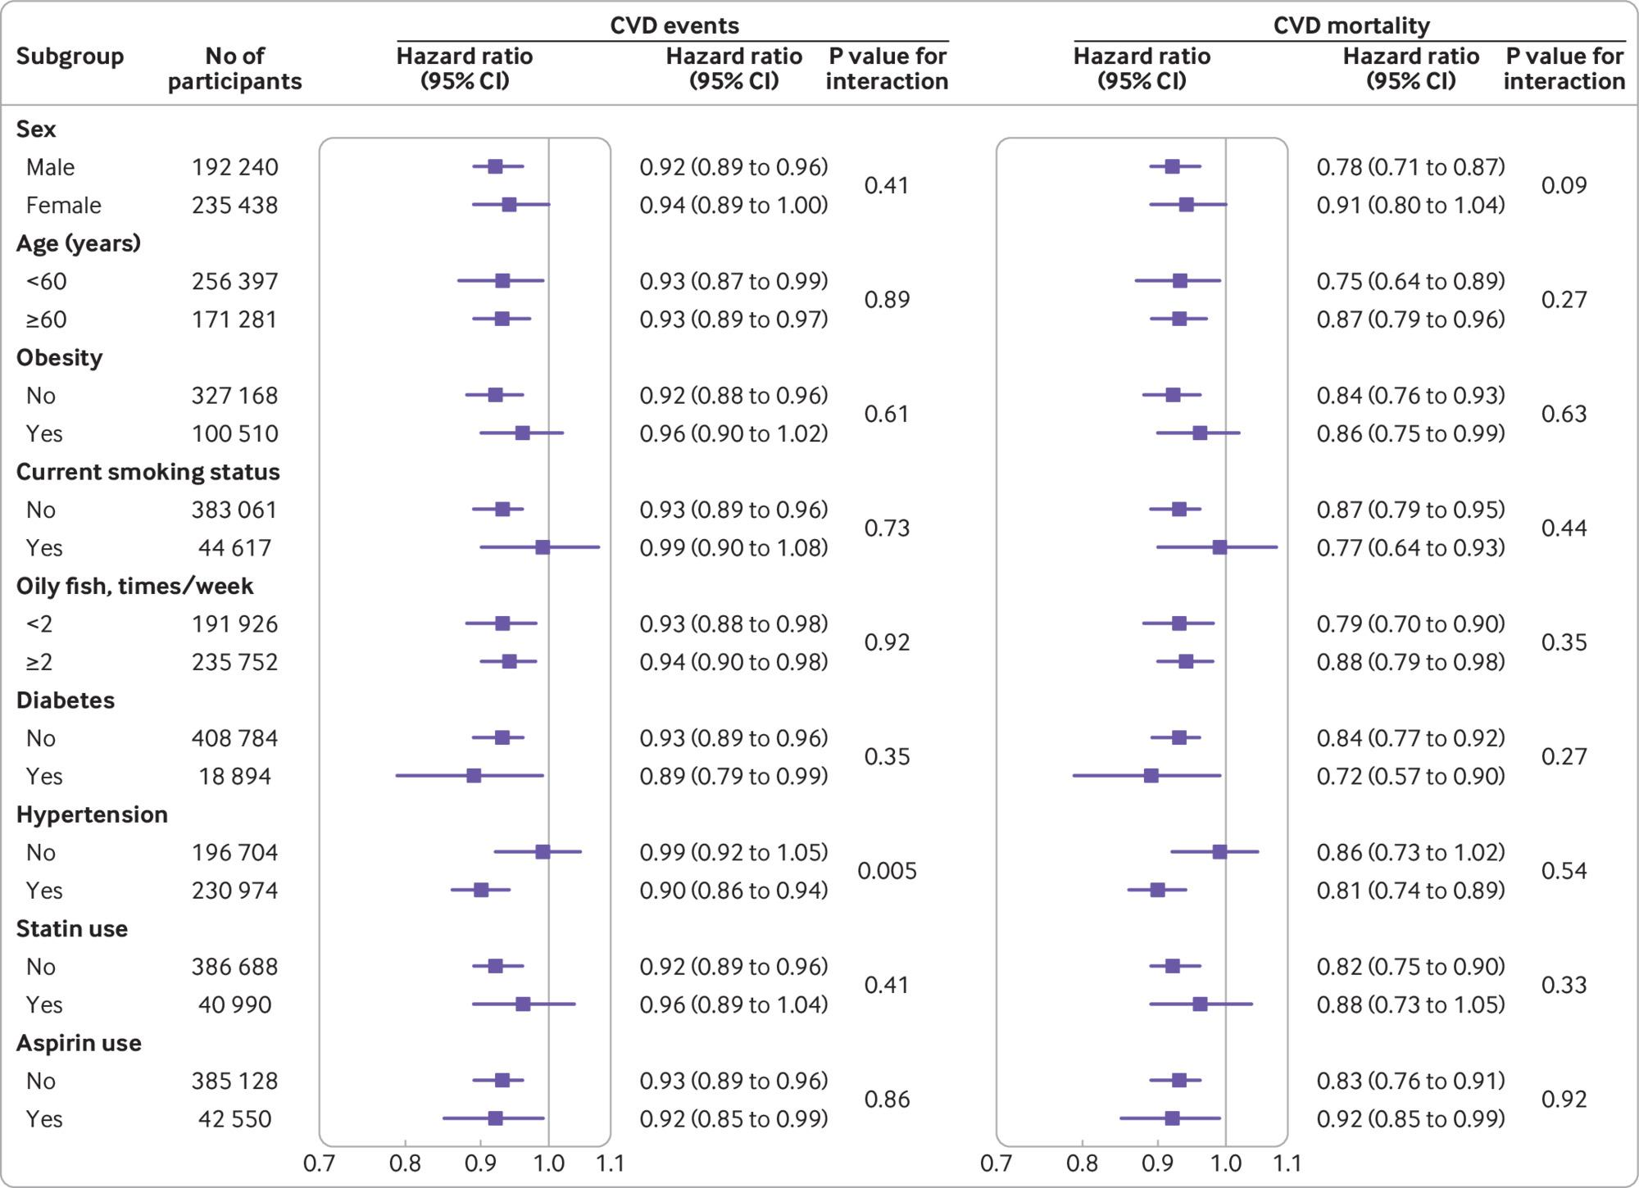
Previous Studies on Health Benefit of Fish Consumption
Study from the UK Biobank
Associations of fish oil supplement use and the risk of cardiovascular events and cardiovascular mortality stratified by potential risk factors
Li et al. 2020

Slide 6
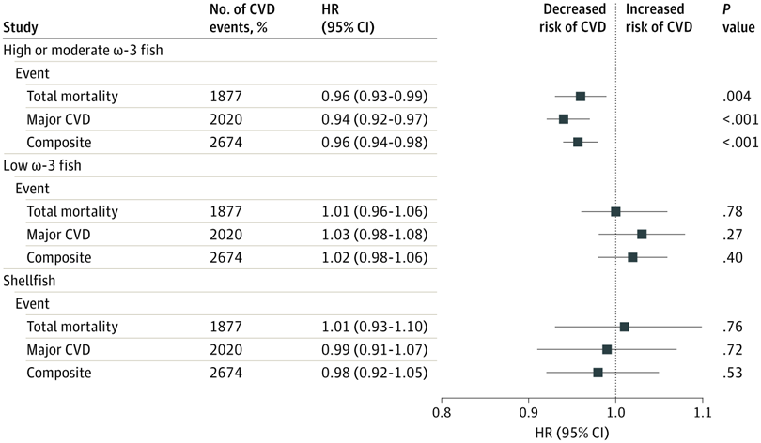
Previous Studies on Health Benefit of Fish Consumption
Associations Between Types of Fish (per 5-g Increment) and Clinical Events in the Outcome Reduction With Initial Glargine Intervention (ORIGIN) Trial (n = 12 422)
Mohan et al. 2021

Slide 7
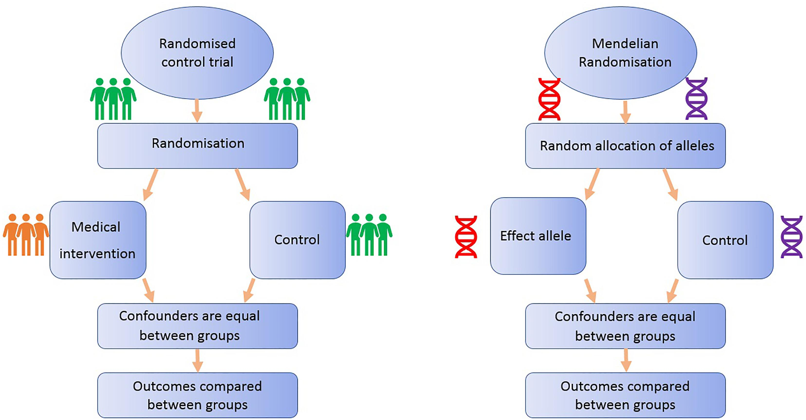
Mendelian randomization (MR) on Fish consumption
Notable Successes of MR
Identified causal links between:
smoking and lung cancer
blood pressure and stroke
Howell et al. 2018.
7/23

Slide 8
Mendelian randomization (MR) on Fish consumption
X
U
1
G Fish Intake CVD
X
U
X
2
G Fish Intake T2D
X
8/23

Slide 9
Study Design
X
U
G Fish Intake CVD
1. Genetic Instrument Selection (from Published studies)
X
2. Selection of Exposure(Fish Consumption) in the UK Biobank: G -> X from UKBB
3. Selection of Outcomes (Using PhenoScanner) G -> Y from cardiogram
9/23

Slide 10
Selection of Genetic Variants Associated with Fish Intake
Study | SNP | No of Participants | Ancestry
Suzuki et al 2021 | rs3782886 rs11066015 rs671 rs11066132 rs144504271 rs116977843 | 16,584 | East Asian
Igarashi et all 2019 | rs11758482 rs12003047 rs11066015 rs1201914 | 12,603 | East Asian
Mozaffarian et 2017 | rs9502823 rs17396472 rs1860343 rs1562806 rs16834168 | 86,467 | European
10/23

Slide 11
Fish Intake Genetic Variants Selection Criteria
Study | SNP | No of Participants | Ancestry
Suzuki et al 2021 | rs3782886⁺⁺ rs11066015 rs671⁺⁺ rs11066132⁺⁺ rs144504271⁺⁺ rs116977843** | 16,584 | East Asian
Igarashi et all 2019 | rs11758482* rs12003047* Rs11066015⁺ rs1201914 | 12,603 | East Asian
Mozaffarian et 2017 | rs9502823 rs17396472 rs1860343 rs1562806* rs16834168* | 86,467 | European
Reasons for removal
⁺ ⁺ Linkage Disequilibrium
⁺ Duplication
** Not in PhenoScanner
* P-value Cut off (>1*10⁻⁷)
11/23

Slide 12
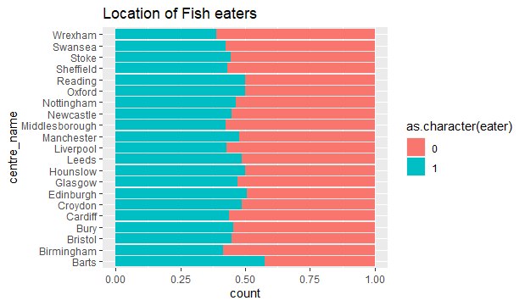

Exploration of Fish Eaters in UK Biobank
Question asked: "Did you eat any fish or seafood yesterday? e.g. at breakfast, takeaway with chips, smoked fish, fish pate, tuna in sandwiches."
UKBB Field ID: 103140
Non-fish eaters
Fish eaters
Ratio
12/23

Slide 13
Exploration of Fish Eaters in UK biobank
UK Biobank Field: 1329
UK Biobank Field: 1339
ACE touchscreen question "How often do you eat other types of fish? (e.g. cod, tinned tuna, haddock)"
ACE touchscreen question "How often do you eat oily fish? (e.g. sardines, salmon, mackerel, herring)"
13/23

Slide 14
Exploration of Fish Eaters in UK Biobank
Percentage of ancestry in high fish eaters
Ancestry | No of eating fish >2 times/week | Percentage of ancestry in high fish eaters | Percentage of High Fish eaters in ancestry
Europeans | 81,540 | 93.54 | 17.8
Africans | 2,218 | 2.54 | 30.5
South Asians | 1,773 | 2.03 | 15.1
East Asians | 984 | 1.13 | 23.6
Mixed | 270 | 0.03 | 18.5
Total | 87175 | 100
Percentage of High Fish eaters in ancestry
14/23

Slide 15
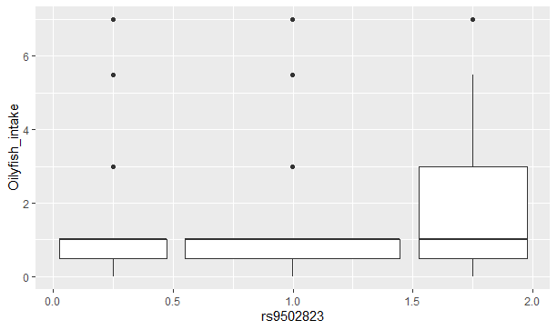
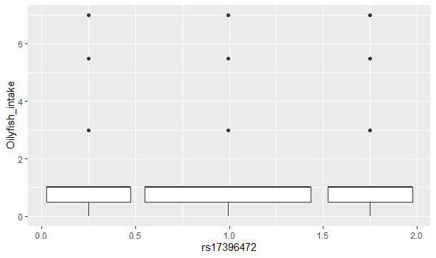

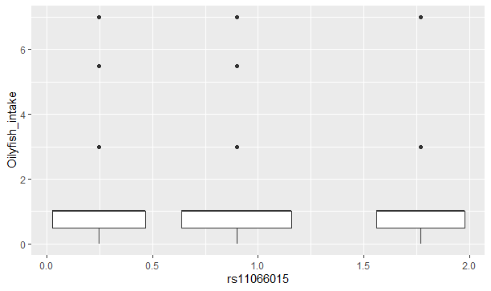
Box Plots of Genetic variants vs Oily Fish intake frequency
15/23

Slide 16
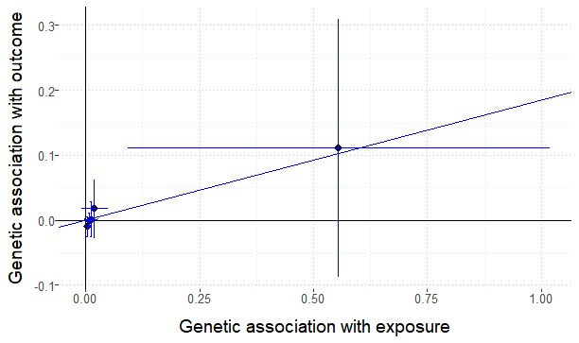
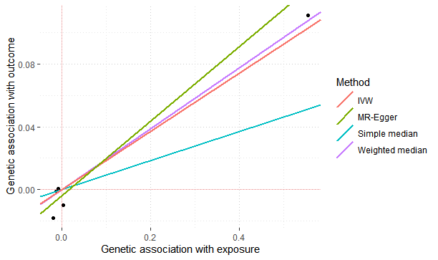
Result: MR plot of Oily Fish Intake and CVD
Method Estimate Std Error 95% CI P-value
Simple median 0.093 0.639 -1.160 1.345 0.885
Weighted median 0.194 18.002 -35.089 35.478 0.991
IVW 0.185 0.173 -0.153 0.524 0.283
MR-Egger 0.239 0.182 -0.118 0.596 0.189
(intercept) -0.004 0.004 -0.013 0.005 0.350
16/23

Slide 17
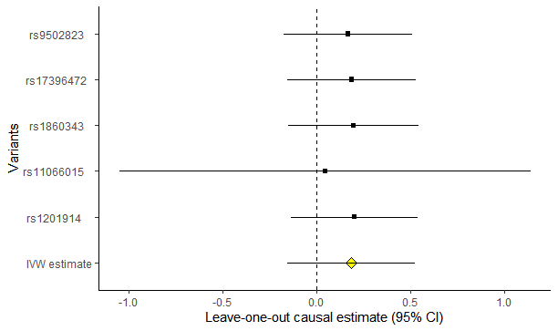
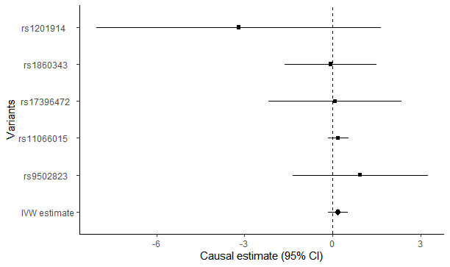
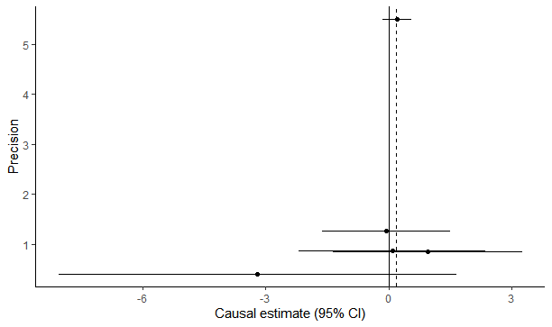
Results: MR plot of Oily Fish Intake and CVD
17/23

Slide 18
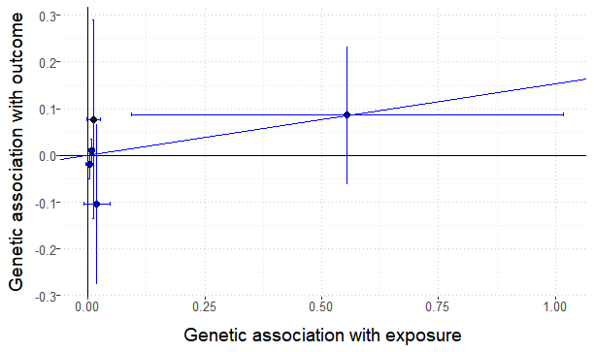
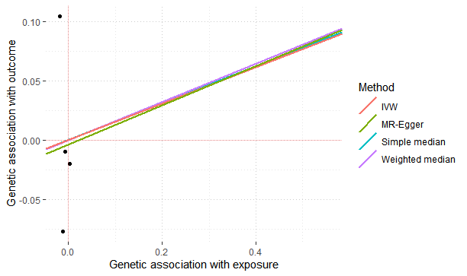
Results: MR plot of Oily Fish Intake and T2D
Method Estimate Std Error 95% CI P-value
Simple median 0.155 2.401 -4.551 4.861 0.948
Weighted median 0.161 15.384 -29.991 30.313 0.992
IVW 0.154 0.140 -0.120 0.428 0.270
MR-Egger 0.165 0.162 -0.152 0.482 0.306
(intercept) -0.004 0.011 -0.026 0.018 0.732
18/23

Slide 19
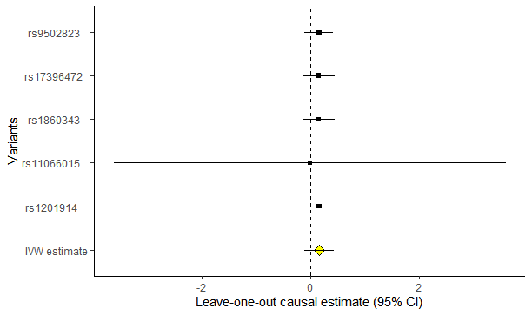
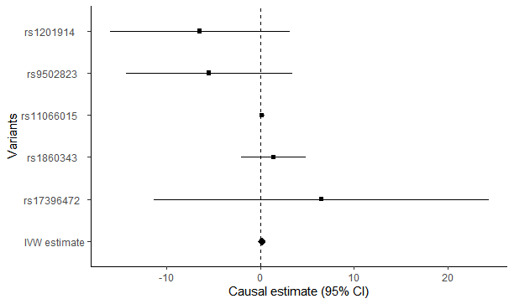
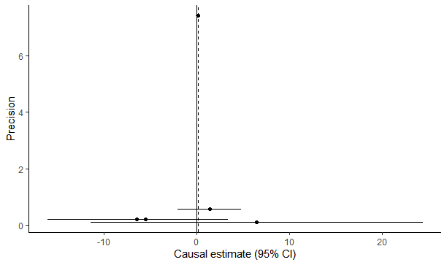
Results: MR plot of Oily Fish Intake and T2D
19/23

Slide 20
Limitations
1. Possible confounders (From PhenoScanner)
SNP | HDL | LDL | BMI | Alcohol
rs9502823 | X | X
rs17396472 | X | X
rs1860343 | X | X
rs11066015 | X | X | X | X
rs1201914 | X | X | X
2. Multivariable MR could pick this up (but time was limited)
3. Issues related to Ancestry/Choosing suitable population that predominantly eat fish
20/23

Slide 21
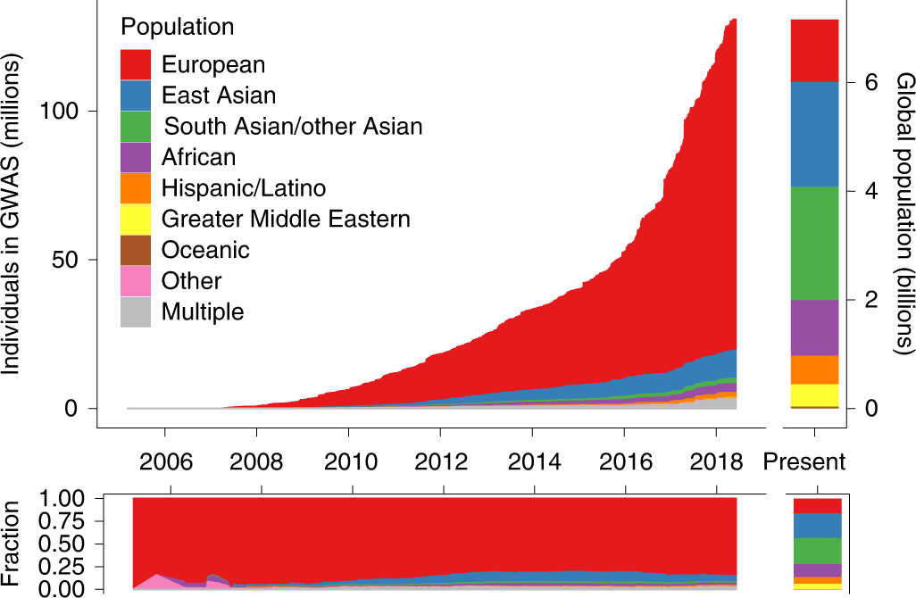
Ancestry of GWAS participants over time compared with the global population
Martin et al. 2019
https://doi.org/10.1038/s41588-019-0379-x
21/23

Slide 22
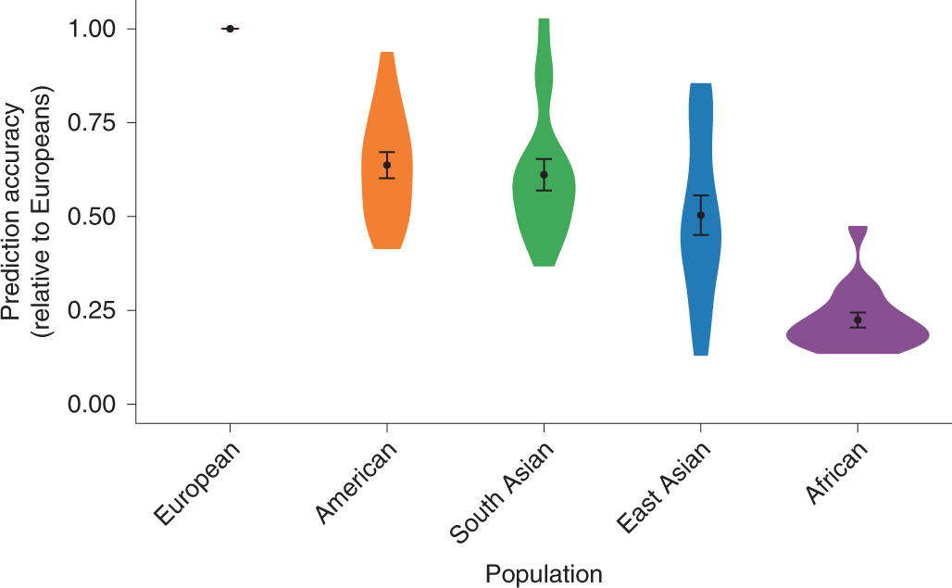
Prediction accuracy relative to European-ancestry individuals across 17 quantitative traits and 5 continental populations in the UKBB
Martin et al. 2019
https://doi.org/10.1038/s41588-019-0379-x
22/23

Slide 23

THANK YOU
23/23

Slide 24
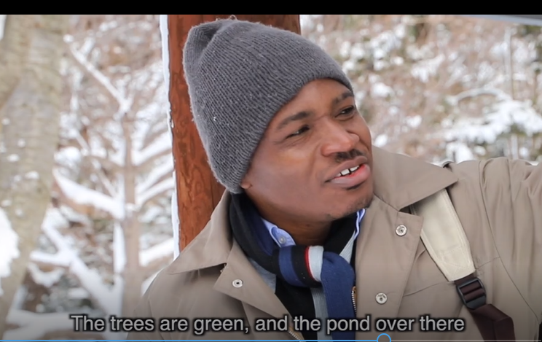
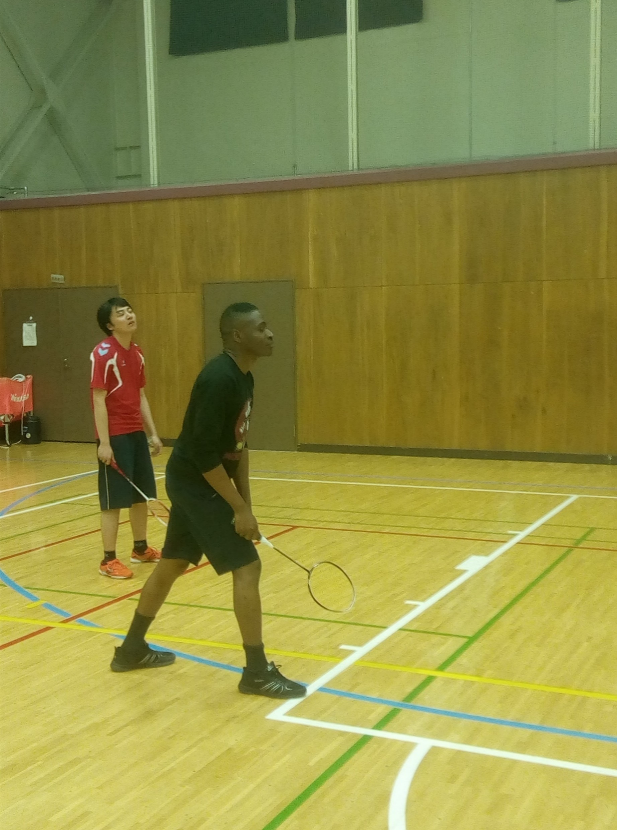

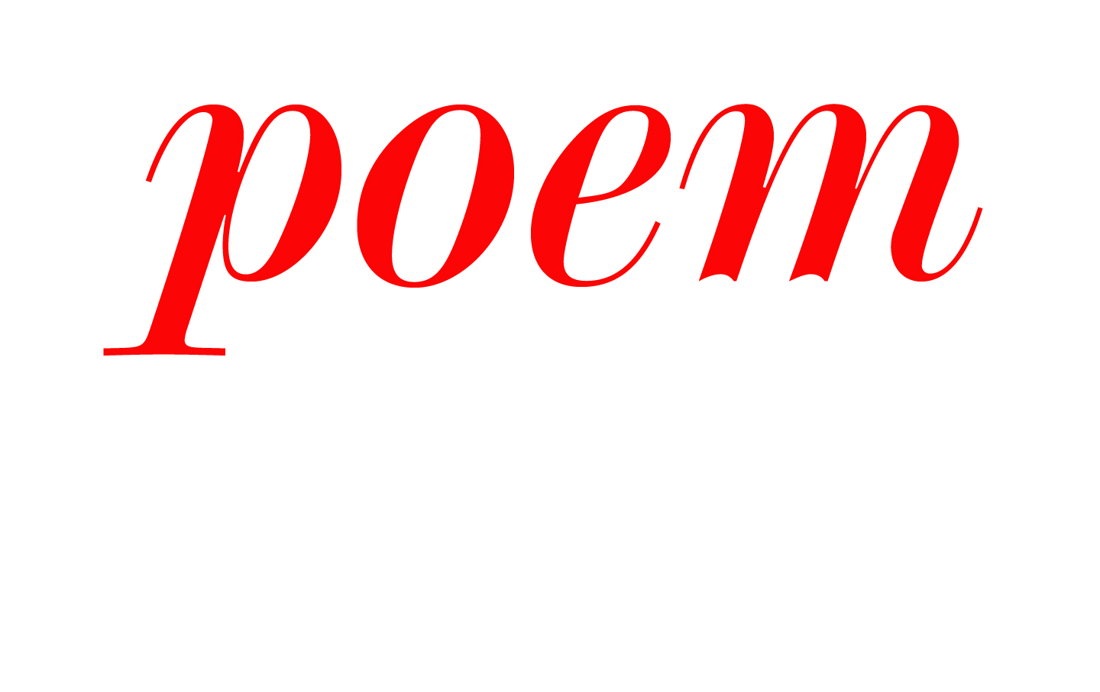
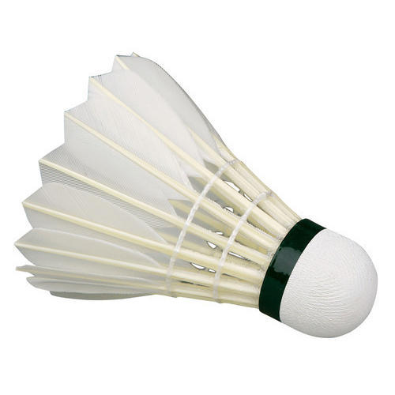
Ifeanyi Chukwu
Introduction
Relevant experiences and qualifications
Health Data Research Intern at CEU Cambridge Uni
MSc Candidate in Applied AI and Data Analytics at Bradford (~Sept 2021)
MSc Marine Life Science, Hokkaido Uni, Japan (2020)
Brief Detail of Current Internship Research Project
Exploring the Black British Cohort of the UK Biobank.
502,520 all participants, ~8,000 Black cohort
Characterising the >200,000 fish eaters in the UK Biobank
Mendelian Randomization to infer the causal relationship between exposure and patient outcome.
Big Picture
To be a competent (AI&ML) Health Data Science Researcher.
Interests
Badminton
Traveling
Reading

Slide 25
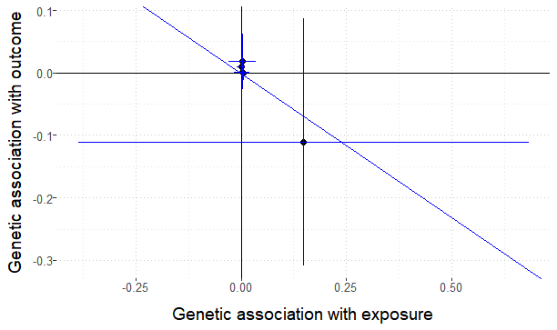
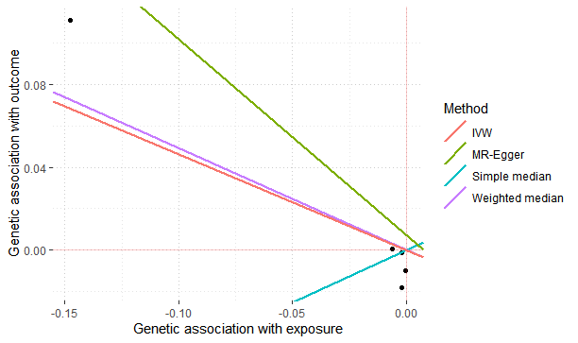
MR plot of Oily Fish Intake and CVD For Female

Slide 26
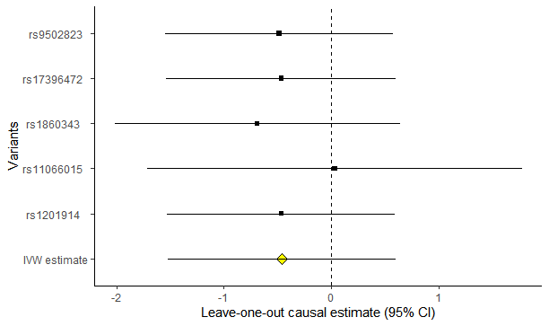
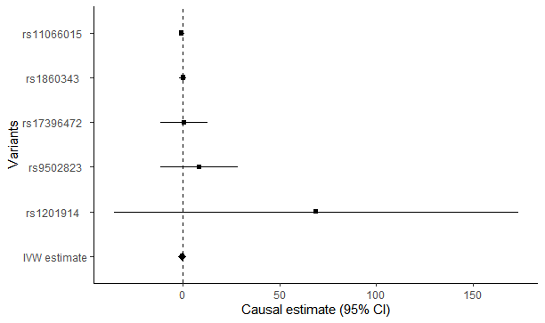
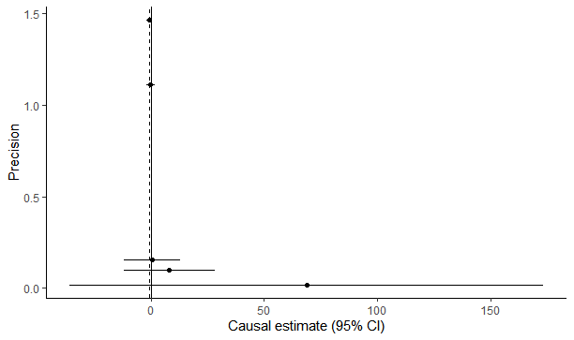

Slide 27
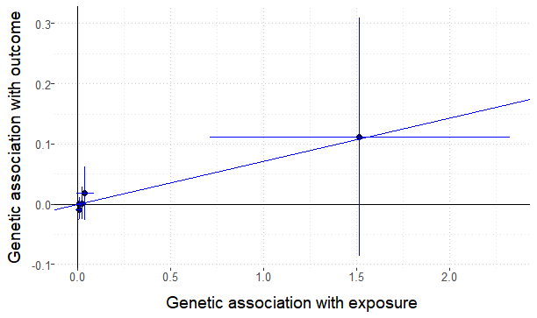
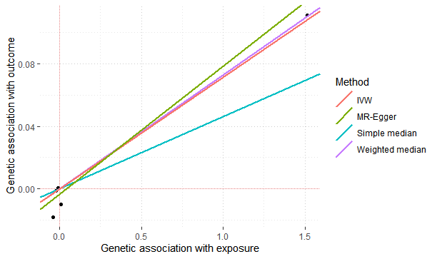
Mr for two or More times Males

Slide 28
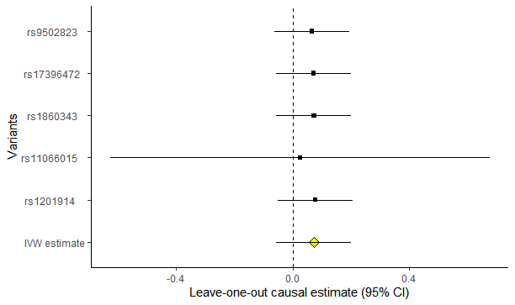
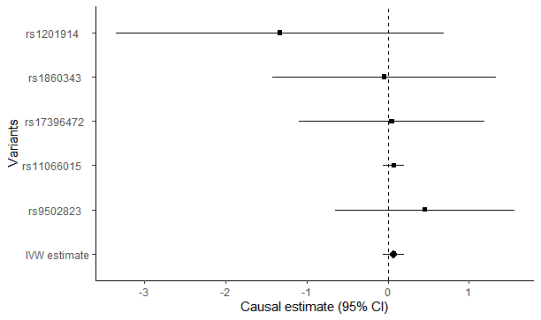
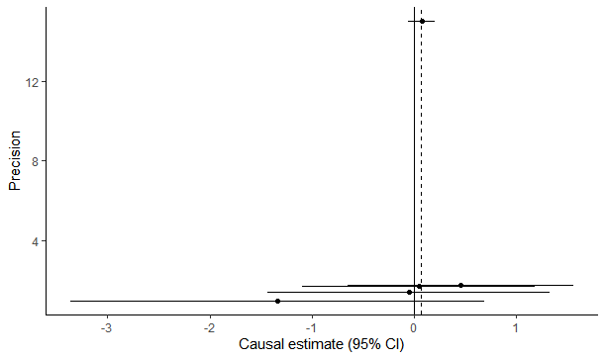

Slide 29
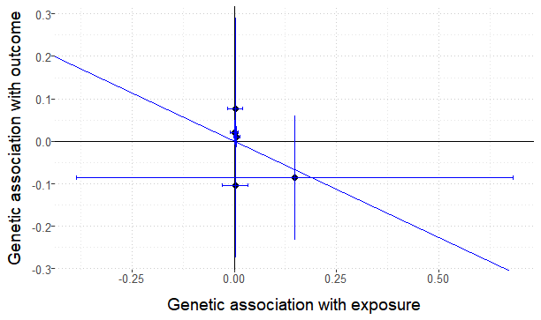
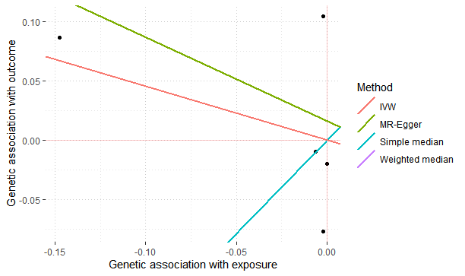
Mr for two or More times Females (T2D)

Slide 30
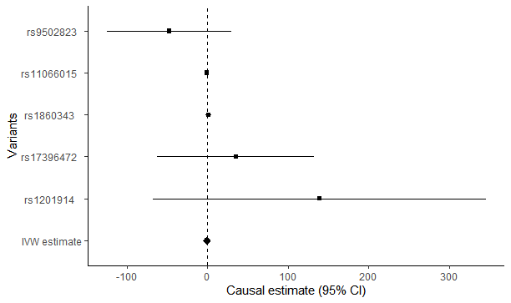
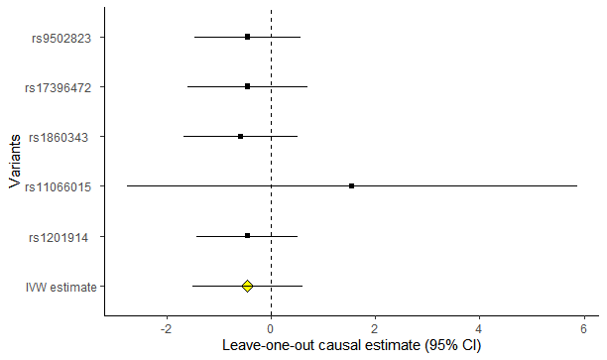
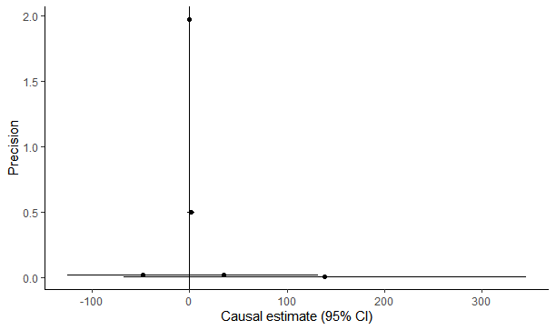

Slide 31
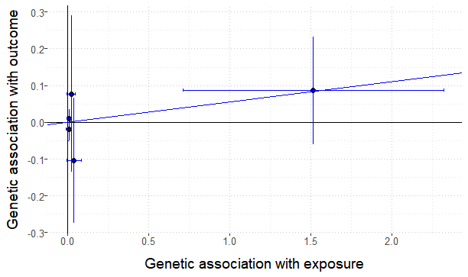
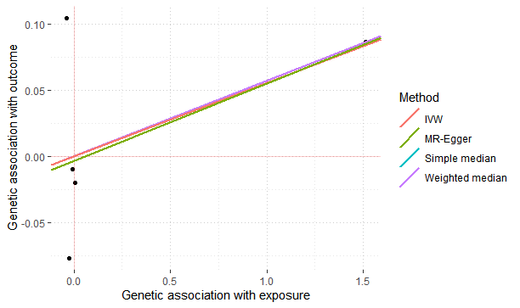
Mr for two or More times Males (T2D)

Slide 32
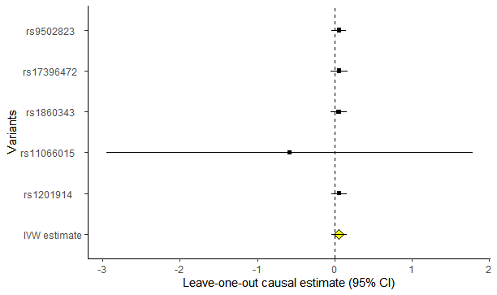

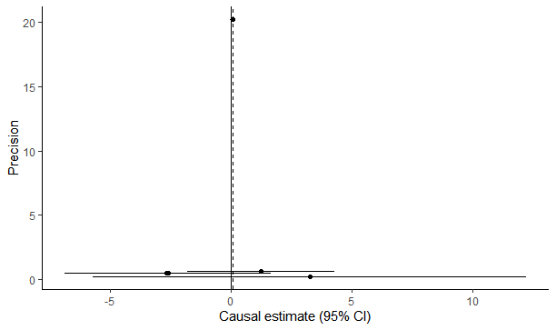

Slide 33

Where this finding might be applied
The Information of the under presented ancestries in GWAS and UK biobank can used for well informed strategies in future similar projects like “Our Future Health”
Our Future Health aims to recruit up to five million people over the age of 18, from all backgrounds and ethnic groups, and from all across the UK to take part.
https://ourfuturehealth.org.uk/

Slide 34

Story of the trauma surgeon
High Mortality of Accident patients in trauma wards
From patients stories, Surgeon suspected a corelation between type of accident and injury
By Philip Bourne, 2019.
(Founding Editor in Chief of PloS Computational Biology)
Surgeon got accident data from dept of Motor Vehicle
Combined with electronic health record, Surgeon found a corelation between type of accident and injury type
Improved trauma patients care
Data Science for the Public Good
Source: https://share.upmc.com/2016/05/er-vs-trauma-center-levels/

Slide 35
211.7M
2021
2050
400.1M
2020
2050

